Slide 1

Wine Up
Price Analysis

Slide 2

(Most Frequent)
| Portfolio - Descriptive
3 Types
(Red)
2 Segments
(Non Exclusive)
35 Varieties
(Grenache)
141 SKUs
14 Regions
(France)
8 Vintage
(2022)

Slide 3
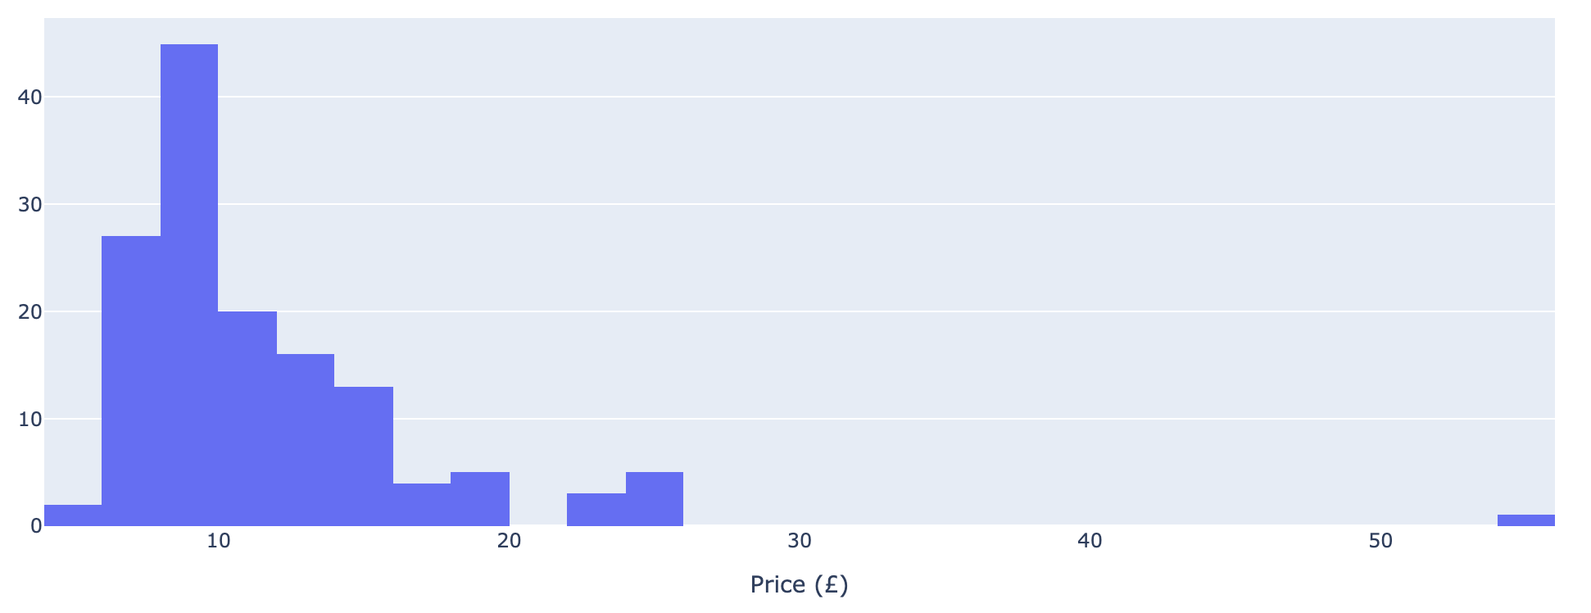
|Exploring - Price
Min
5.4
Mean
9.9
Distribution(Std)
5.6
Max
54.9
Number of Wines
Price
Main
Highlights
Healthy and progressive price distribution, with core products and premium scale
Products with Max price may look like a significant change to their regular basket.

Slide 4
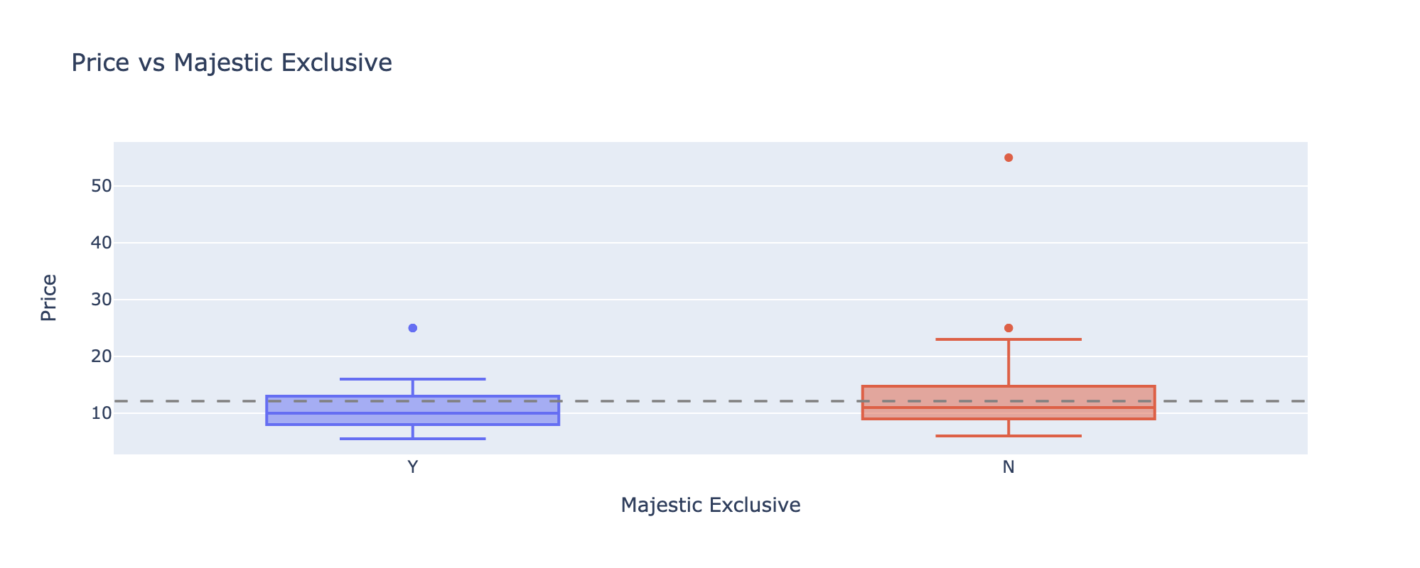
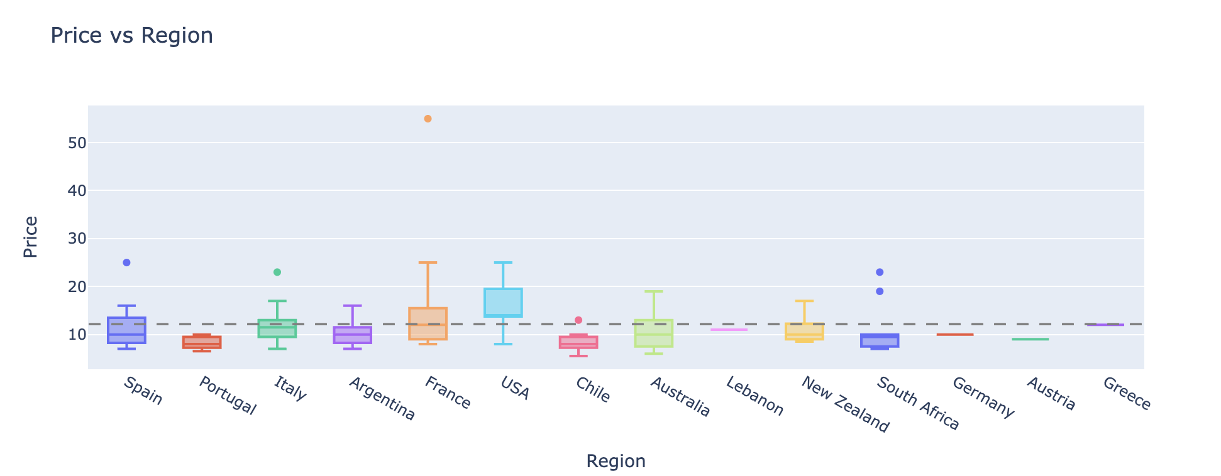
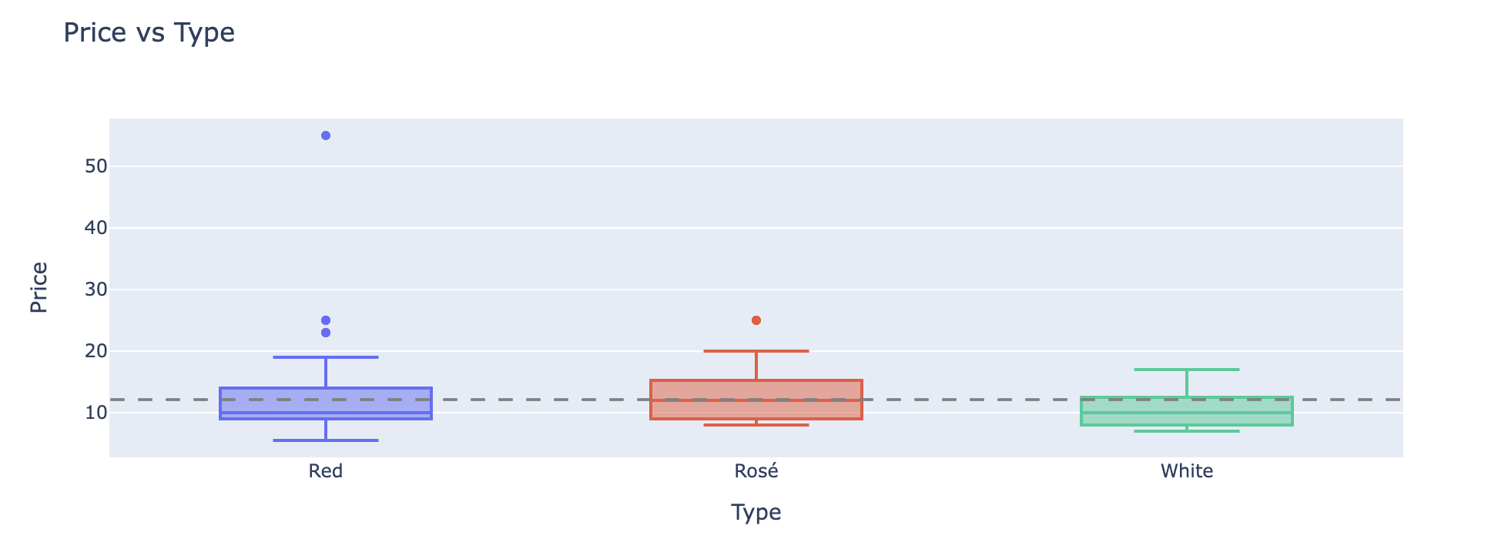
|Exploring - Price
Main
Highlights
Is the Price Distribution aligned with the portfolio strategy?
E.g.
White wine is the cheapest one.
France and USA are the most expensive producers
Non-exclusive products are slightly more expensive

Slide 5
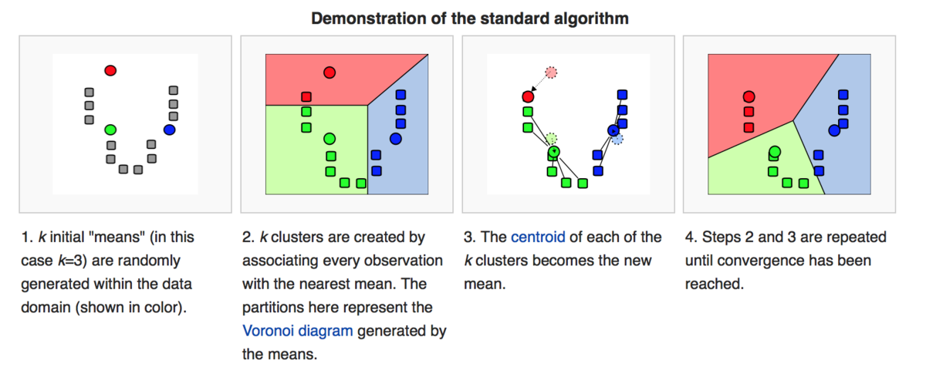
|Modeling – Price Clusters
Use machine learning to go deeper and explore new relations based on custom price clusters
K-Means
Price Distribution Before K-Means
Methodology
Price Distribution After K-Means
K-Nearest Neighbors (KNN) is a simple, yet powerful machine learning algorithm. In very basic terms, imagine that you have a bunch of dots on a paper. Each dot represents a data point. Now, if a new dot appears and you want to know where it belongs, you would look at its closest neighbors. If most of its nearest neighbors are blue, you might guess that this new dot should also be blue. That's the basic idea of KNN: it classifies or groups new data points based on their similarity (or "closeness") to existing data points.

Slide 6
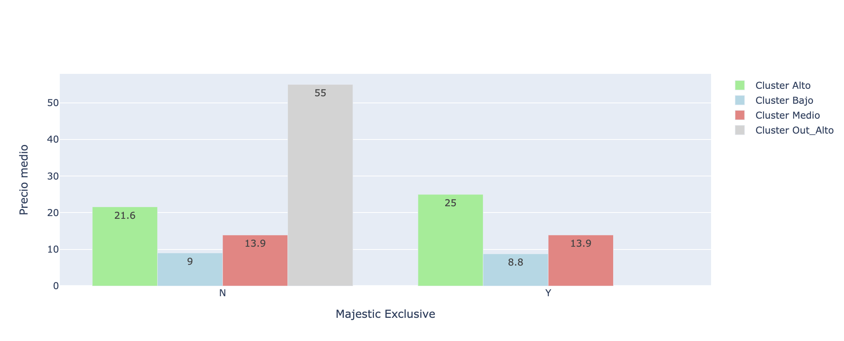
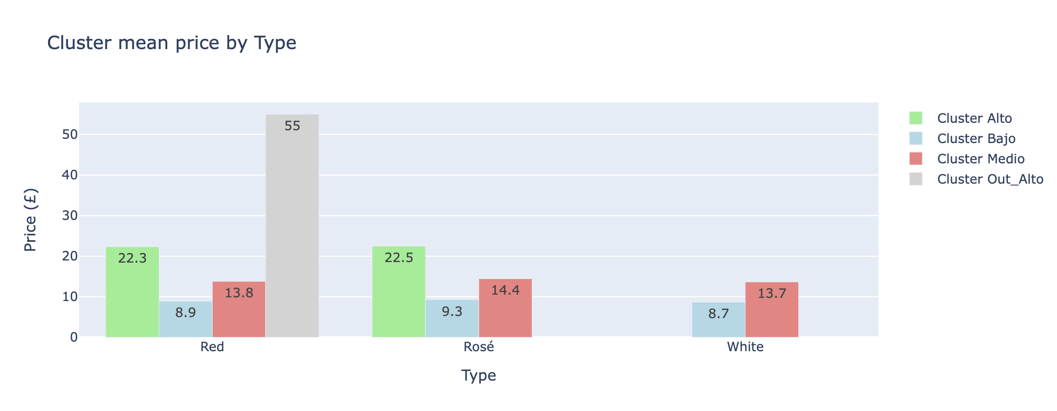
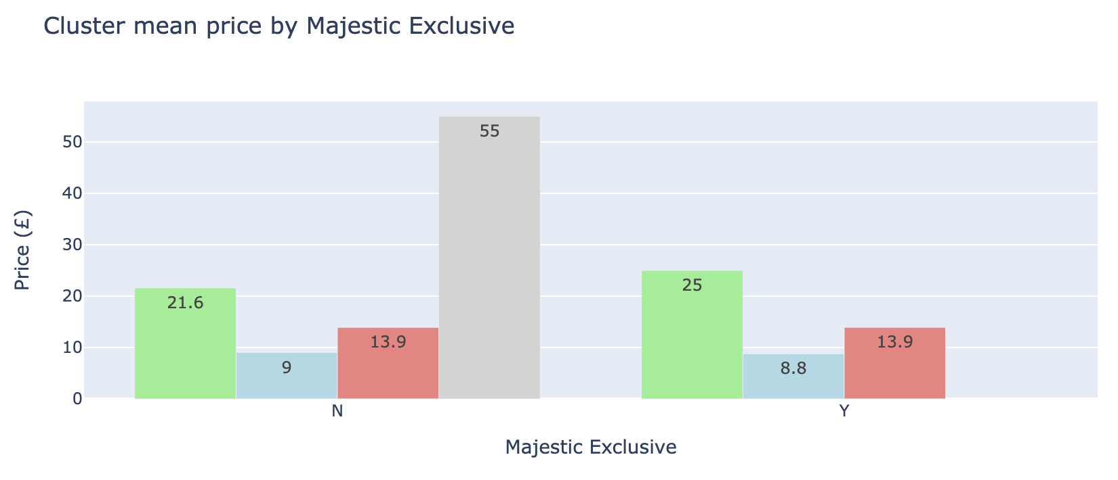
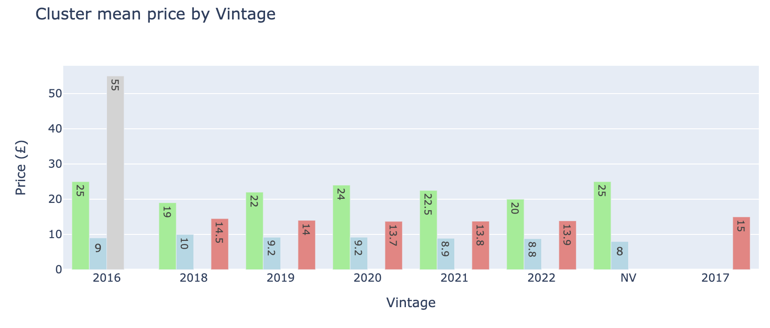
|Price Clusters Analytics
Main
Highlights
White wine has an opportunity to introduce a more expensive SKU of $22 Avg. and track more revenue
Wines from 2016 Vintage may have an opportunity to introduce a mid-price SKU.
The “Exclusive” strategy may not be aligned with the price strategy.

Slide 7

*Hours(Hrs.) may change depending on the business data system and tools
|Next Steps & Implications
[Logistic Regression]
[‘Char’ Column evaluation]
[Sales Correlation]
[Core KPIs Dashboard]
Machine Learning Model to understand variable importance on price structure
3 Hrs.
Analyze if a particular product characteristic is correlated with Sales growth
Pending
This column requires more complex analysis. We need to validate with the business its relevance.
2 Hrs.
Daily Core KPIs Follow UP ( Coverage – Sales Volume)
15 Hrs.*

Slide 8

Eduardo Manotas
“Collect – Analyze – Act – Repeat”
Business Intelligence
https://www.linkedin.com/in/eduardo-manotas-106b0b67
eemc0126@gmail.com
+1 3432978131
Wine-Up

Slide 9
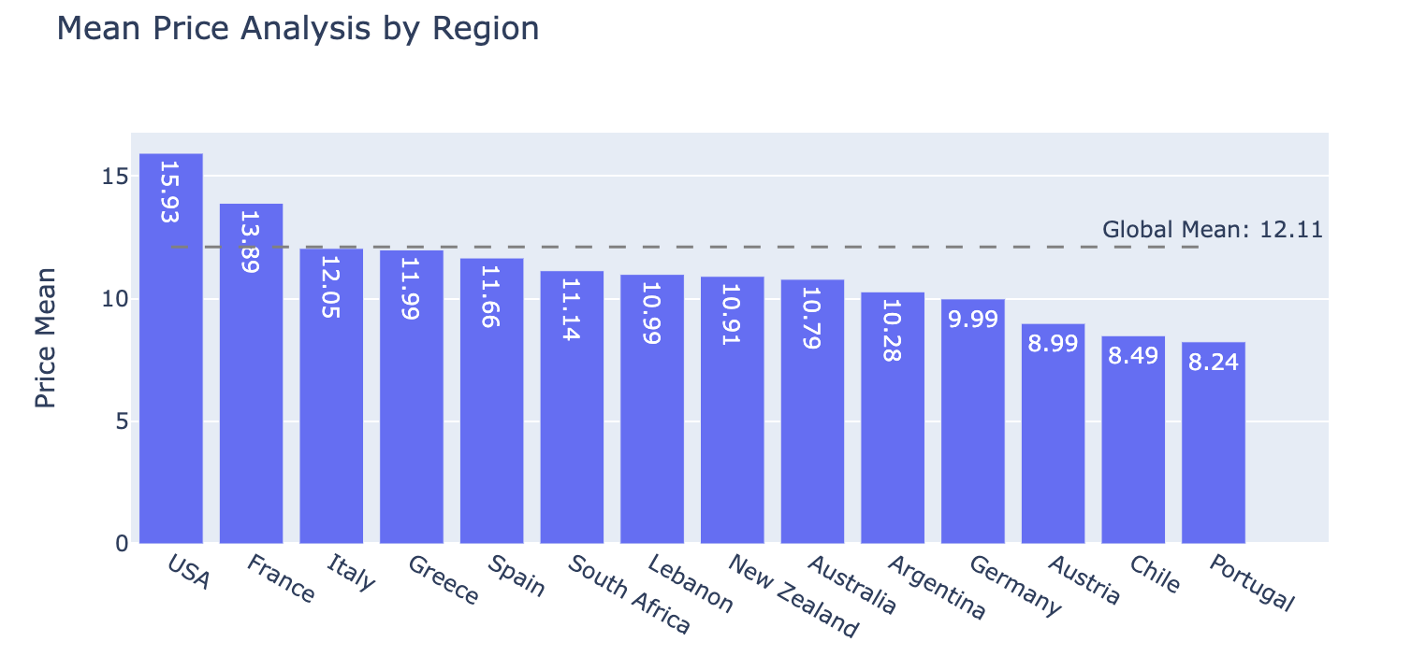
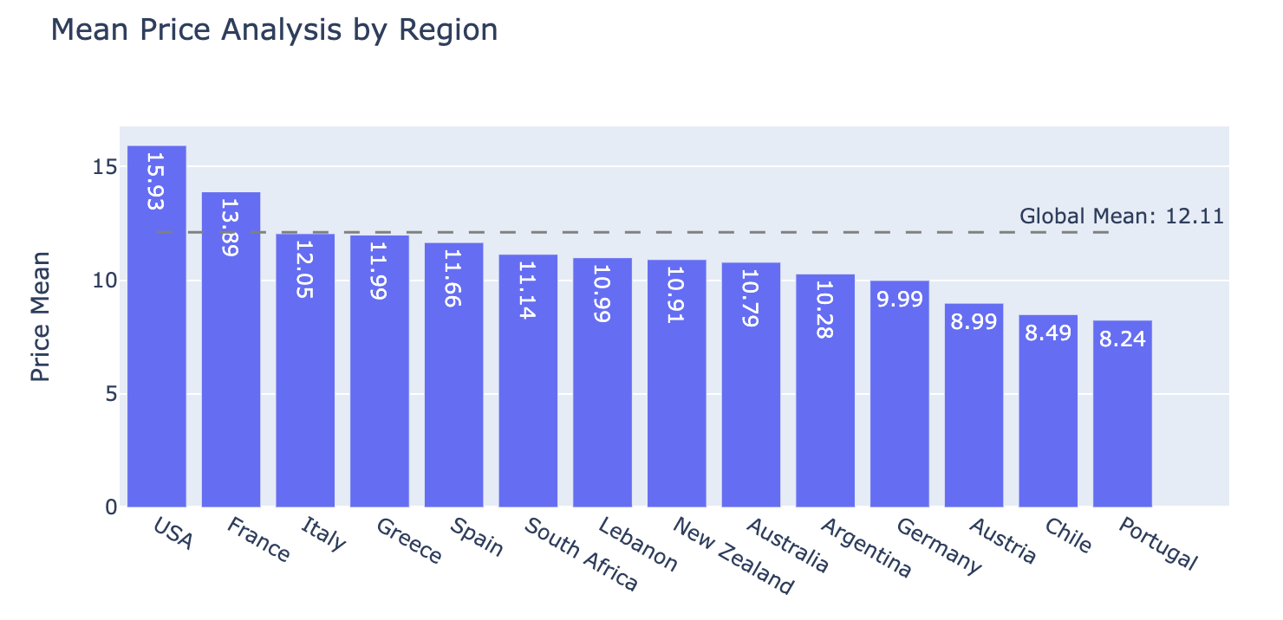
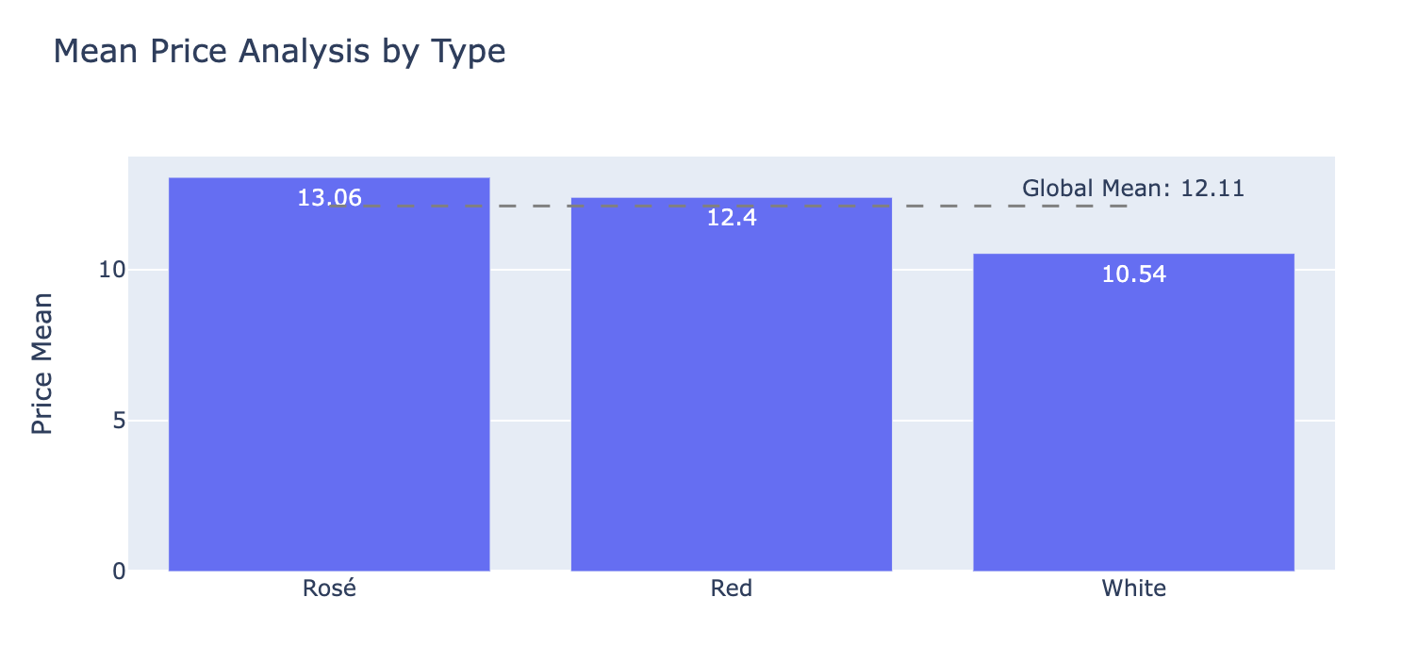
|Exploring - Price
Main
Highlights
Healthy and progressive price distribution, with core products and premium scale
Products with Max price may look like a significant change to their regular basket.

